Slide 1

Stock Market Trading & Portfolio Performance Analytics Platform
End-to-End Data Analytics Platform
- Presented By : Pranathi Maganti

Slide 2

Business Problem
Stock data arrives as separate daily CSV files with no consolidation
Manual calculations lead to inconsistent return and risk metrics
Raw price data lacks standard structure and historical alignment
High probability of human errors in analysis
No portfolio-level view across multiple stocks
Difficult to analyze long-term trends and patterns
Time-consuming and not scalable as data grows
No reliable single source of truth for decision-making

Slide 3
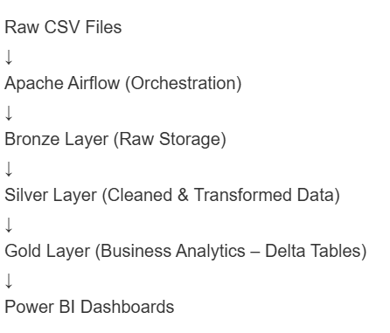
Project Objectives
Automated stock data ingestion
Time-series & portfolio analytics
Scheduled ETL using Apache Airflow
Scalable processing using Databricks & Spark
Interactive dashboards in Power BI

Slide 4

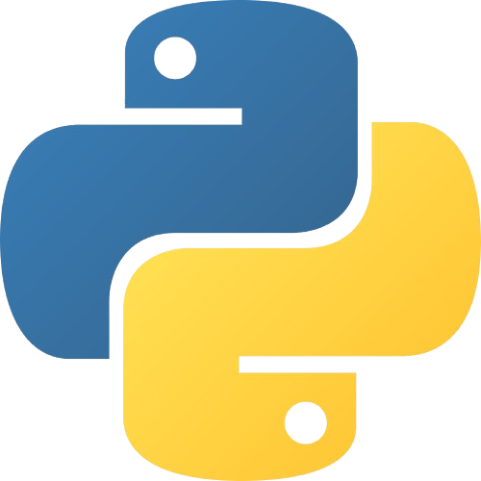


Technology Stack
Tools Used:
Apache Airflow – Orchestration & scheduling
Python – Data ingestion & transformations
Databricks (Apache Spark) – Scalable analytics
Power BI – Dashboards & reporting

Slide 5
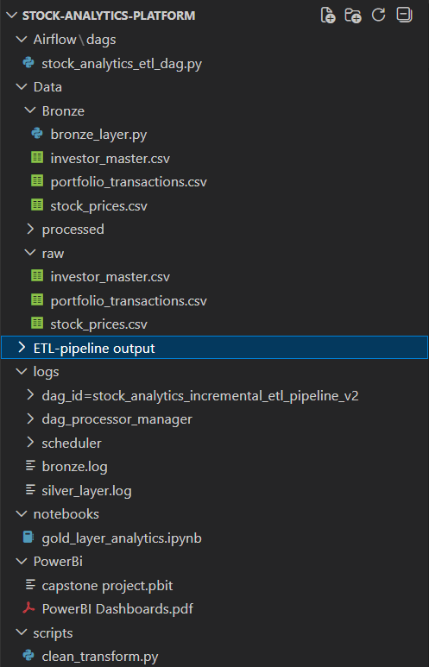
Datasets Used
1. Stock Prices (stock_prices.csv)
Daily stock market price data used for return, volatility, trend, and sector analysis.
Key Fields: Trade Date, Symbol, Company, Sector, Open, High, Low, Close, Volume, Market Cap, Exchange
2. Portfolio Transactions (portfolio_transactions.csv)
Simulated investor BUY/SELL transactions used to dynamically derive portfolio holdings.
Key Fields: Transaction ID, Trade Date, Investor ID, Symbol, Action, Quantity, Trade Price
3. Investor Master (investor_master.csv)
Investor metadata used for risk profiling and segmentation analytics.
Key Fields: Investor ID, Investor Type, Risk Profile, Region

Slide 6
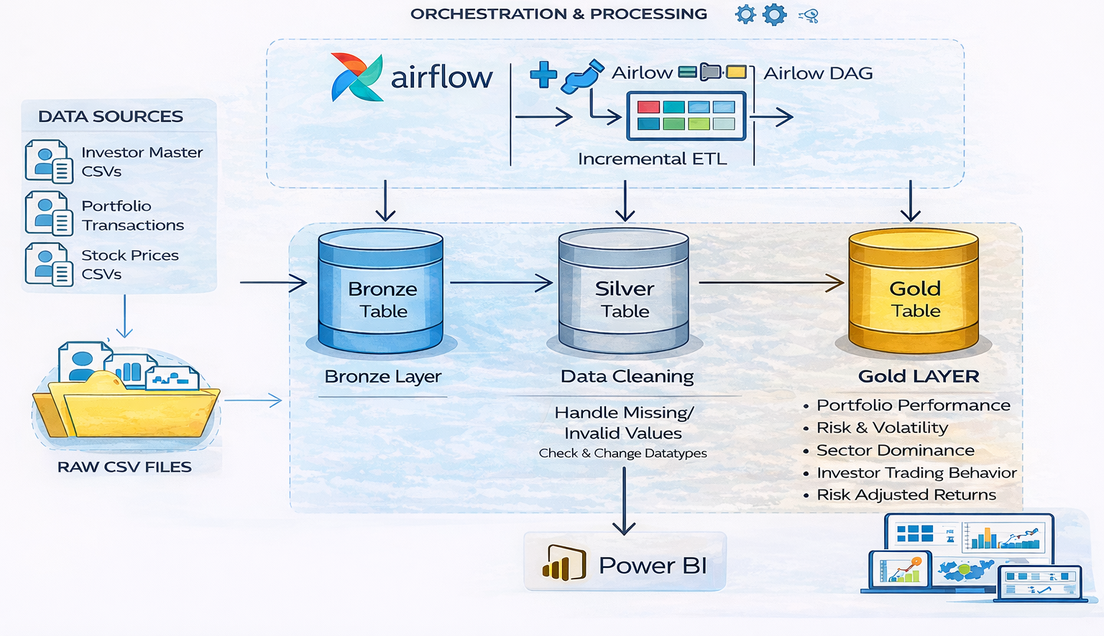
END TO END STOCK ANALYTICS DATA PLATFORM

Slide 7
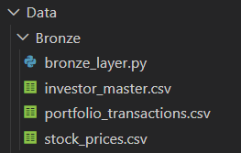
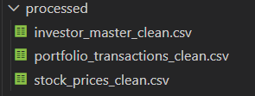
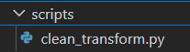
Bronze Layer
Raw Data Ingestion
Silver Layer
Data Cleaning & Transformation
Stores data exactly as received
No transformations applied
Maintains data traceability
Supports reprocessing and recovery
Executed via Airflow tasks
Handles missing and invalid values
Removes duplicate records
Standardizes data types
Performs feature engineering (daily returns)
Produces analytics-ready datasets

Slide 8
Gold Layer Analytics
Business-Focused Insights:
Portfolio Performance : Calculates total portfolio value over time to track overall investment
growth.
Risk & Volatility Analysis : Measures price fluctuations to identify high-risk and stable stocks.
Sector Dominance : Aggregates trading activity by sector to identify leading and underperforming
sectors.
Investor Trading Behavior : Classifies investors based on trading frequency to understand
behavior patterns.
Risk-Adjusted Returns : Evaluates returns relative to risk to identify efficient investment
opportunities.
All tables are optimized for direct Power BI visualization and analysis.

Slide 9
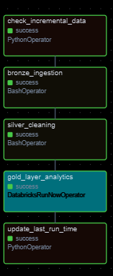
Airflow Orchestration
Entire ETL pipeline orchestrated using a single Airflow DAG
Supports daily scheduled runs and manual execution
Strict task dependencies enforce correct execution order
Prevents downstream execution if any upstream task fails
Databricks Integration:
Databricks analytics triggered from Airflow using DatabricksRunNowOperator
The Databricks connection and Job ID are externalized using environment
variables and AirflowVariables.
Airflow controls execution, while Databricks handles scalable computation.

Slide 10
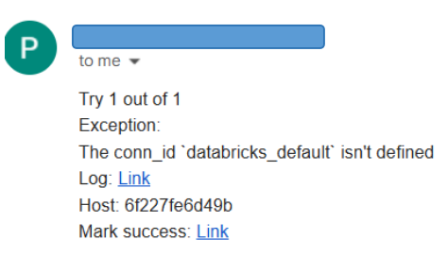
Automated Failure Notifications (Email Alerts)
Pipeline uses Apache Airflow’s native email alerting for proactive
failure detection
Email notifications are triggered only when critical tasks (Gold layer) fail.
Alerting is configured using built-in Airflow settings:
email_on_failure = True
email_on_retry = False
SMTP configuration is managed at the Docker environment
level
Enables immediate failure visibility without manual monitoring

Slide 11
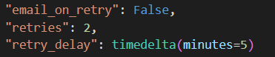
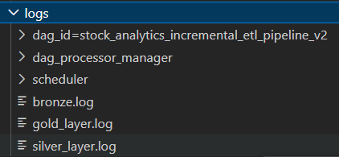
Monitoring, Logging & Error Handling
Airflow Monitoring
Real-time tracking of DAG runs, task states, retries, and execution duration
Graph, Gantt, and Tree views provide clear dependency and status visibility
Retry & Failure Handling
Centralized retry policies defined at the DAG level
Automatic retries with configurable delays
Downstream execution stops on failure to prevent bad data propagation
Layer-wise Application Logging
Bronze: Ingestion events, file operations, missing data errors
Silver: Cleaning steps, transformations, feature engineering logs
Gold: Execution status tracked through Airflow task logs
Centralized Log Storage
Logs stored at /opt/airflow/logs inside containers
Docker volume mapping enables local log access from VS Code

Slide 12
PowerBI - Dashboards Developed
Stock Price Trend Dashboard : Analyzed sector-wise price behavior, trading volumes, and volatility to understand market structure and sector dominance.
Portfolio Performance & Return Analysis : Evaluated portfolio value trends, momentum, risk-adjusted returns, and performance distribution over time.
Investor Behaviour Analysis : Studied investor activity patterns, trading intensity, top investors, and behavior classification (long-term vs swing traders).
Risk & Volatility Indicators : Assessed stock-level and sector-level risk using volatility measures, risk efficiency scores, and risk–return relationships.

Slide 13
Data Modeling, Analytics & Visualization
Cleaned and transformed stock data using Power Query, including missing value handling and derived columns
Built a structured data model to enable accurate aggregations and cross-filtering
Implemented advanced DAX measures for portfolio performance, risk metrics.
Enabled risk-adjusted and momentum-based analytics beyond basic aggregations
Applied conditional formatting, consistent color themes, and KPI cards for quick insights
Enabled interactive slicers, Top-N filters, and automatic data refresh in Power BI

Slide 14
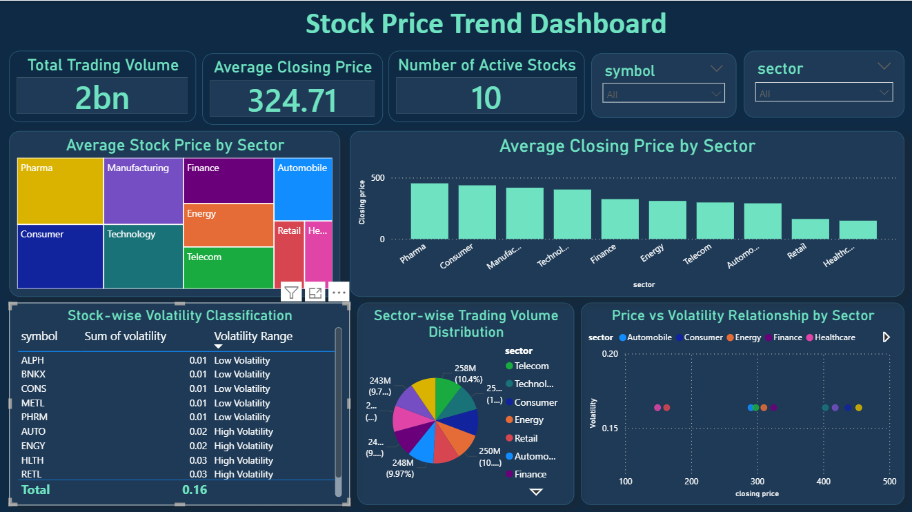

Slide 15
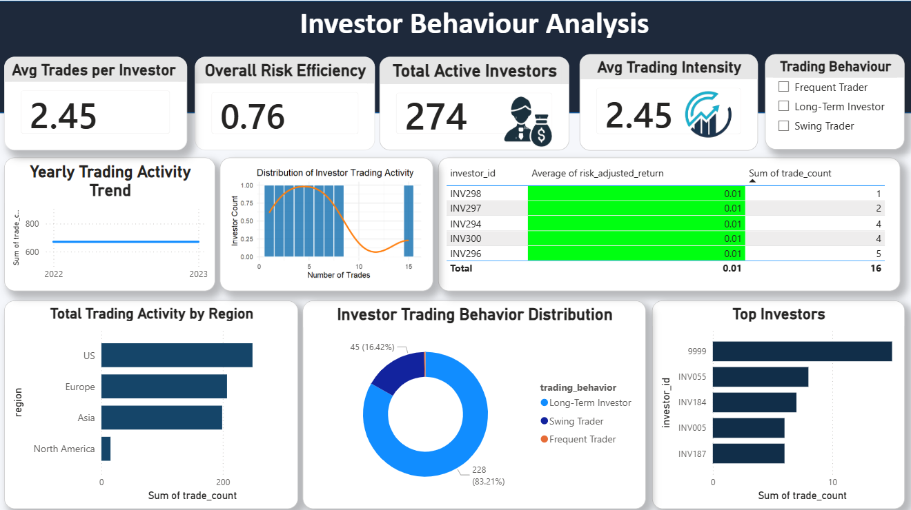

Slide 16
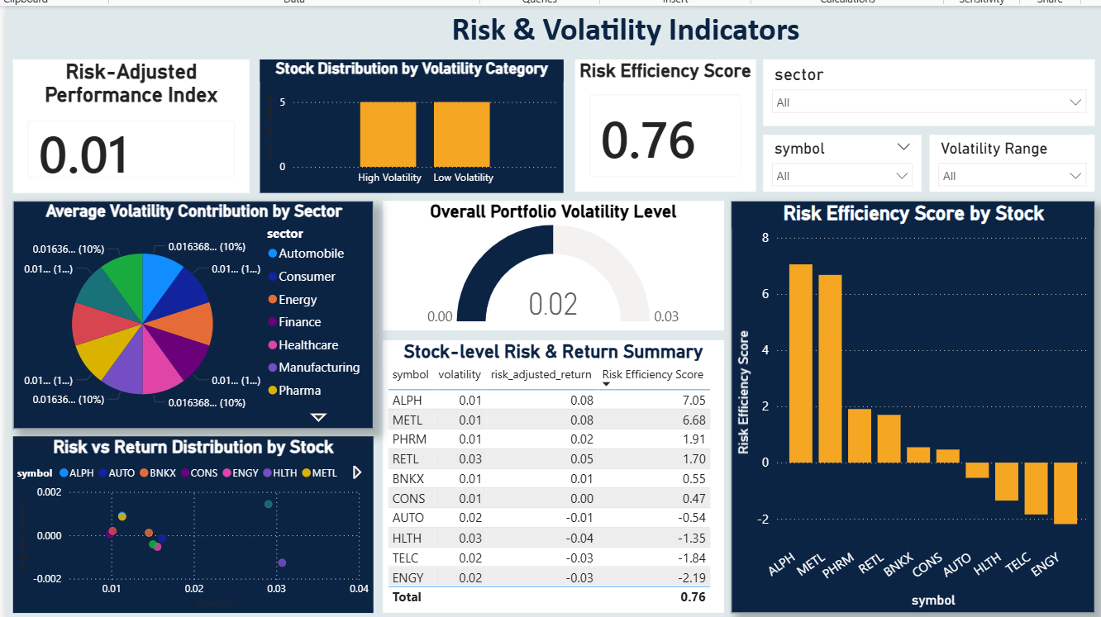

Slide 17
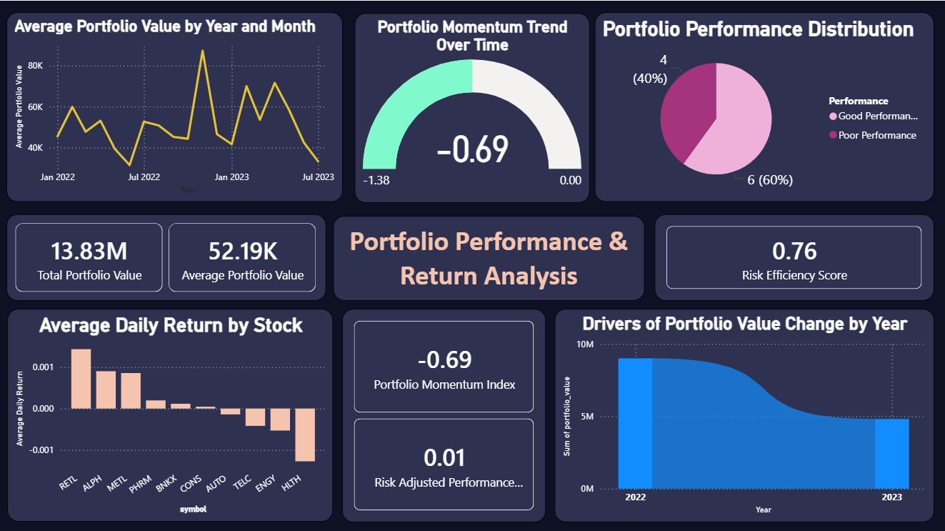

Slide 18
Conclusion and Future Scope
Conclusion:
Built an end-to-end automated stock analytics pipeline using a Bronze–Silver–Gold architecture.
Implemented reliable orchestration with Apache Airflow, scalable analytics using Databricks, and interactive insights through Power BI.
Enabled incremental processing, monitoring, and alerting, ensuring production-level reliability and performance.
Future Scope
Integrate machine learning models for stock trend prediction and risk forecasting.
Enhance data quality checks, anomaly detection, and alerting mechanisms.
Expand analytics to cover multiple markets and asset classes.

Slide 19
Thank You

